Slide 1
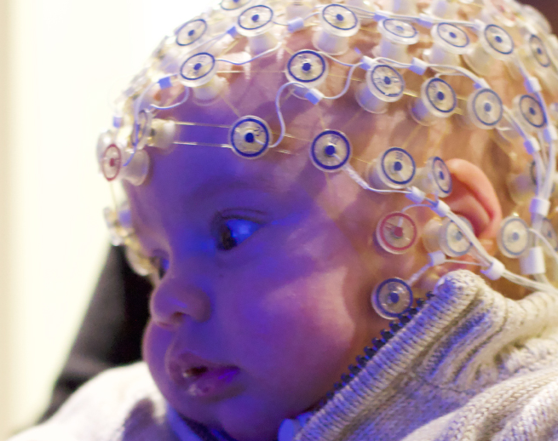
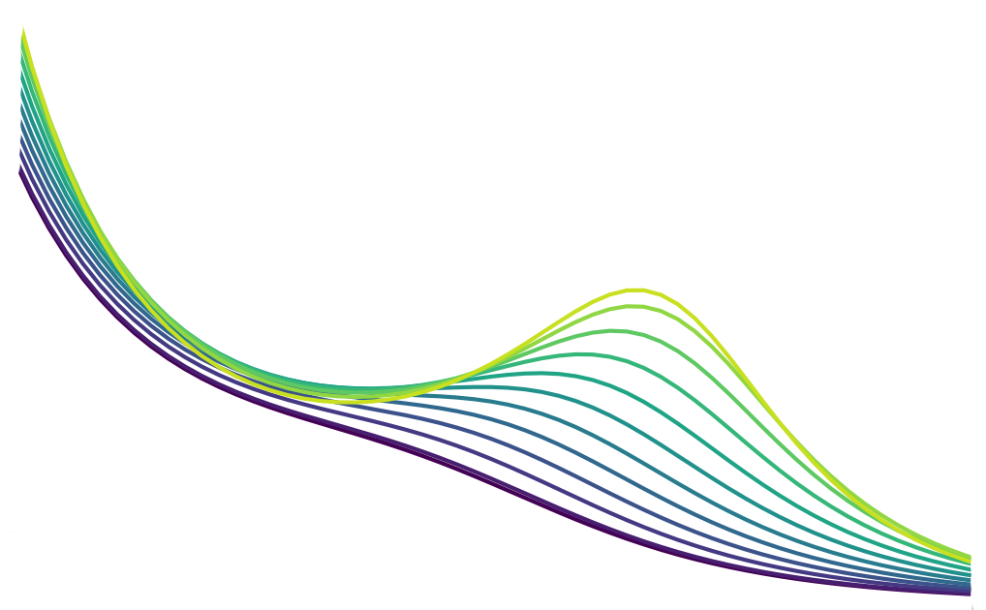
Modelling Infant Brain Activity
By: Daniel Lyon
Supervisor: Dr James Roberts

Slide 2
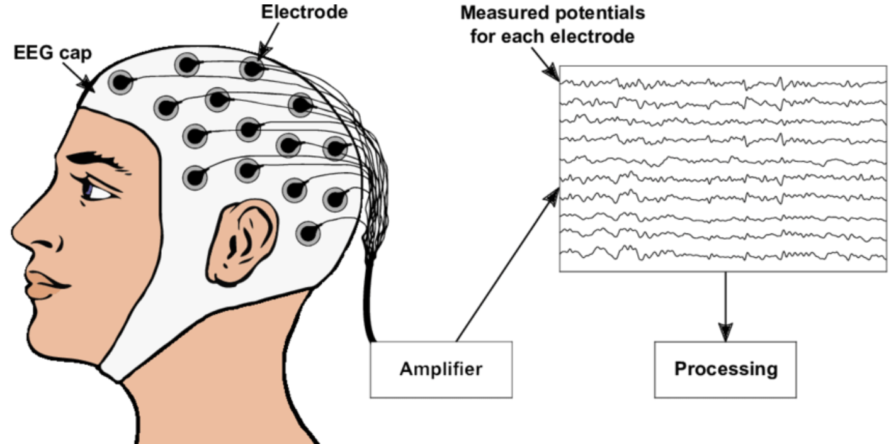
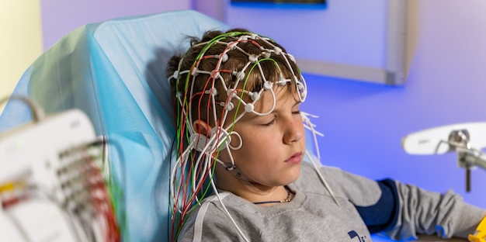
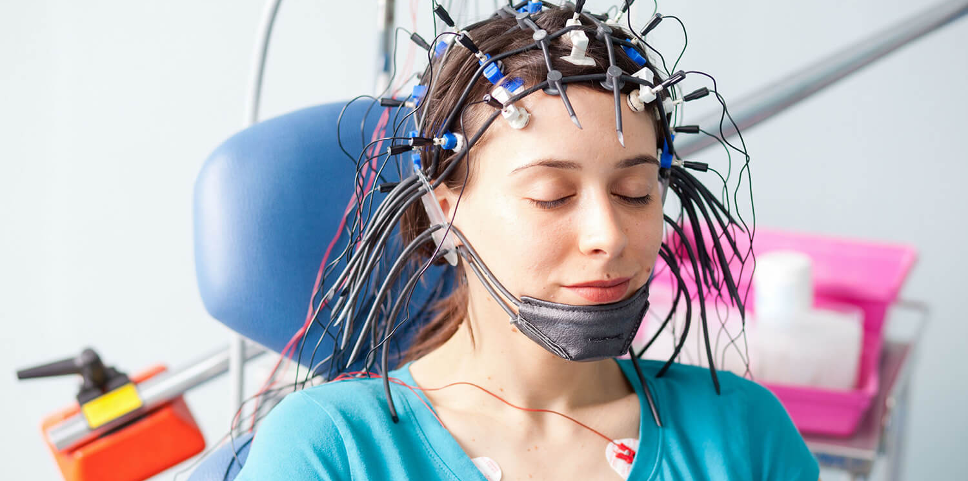
Measuring Brain Activity The Traditional Way
Figure 1: Diagram of how EEG is recorded
Electroencephalograms (EEG) measure electrical signals from a patient’s brain activity (figure 1).
Non-invasive, can help identify sleep disorders, tumors, brain damage, autism, strokes, seizures, etc.
Focus on brain’s response to sensory, cognitive, and motor stimuli.

Slide 3

So Why Model Infant Brain Activity When We Can Gather Data Empirically?
Babies spend on average 14-17 hours sleeping and 1-3 hours crying (sometimes at the same time!)
This behaviour makes it very difficult to take accurate EEG measurements
Empirical EEG data at younger ages becomes increasingly scarce.
EEG caps designed for adults, not designed for children, especially infants who are fragile

Slide 4
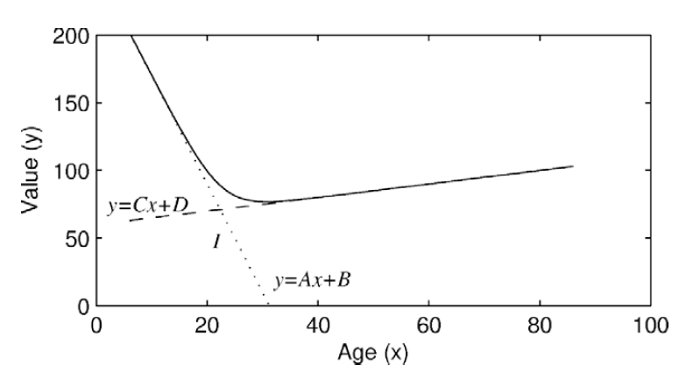
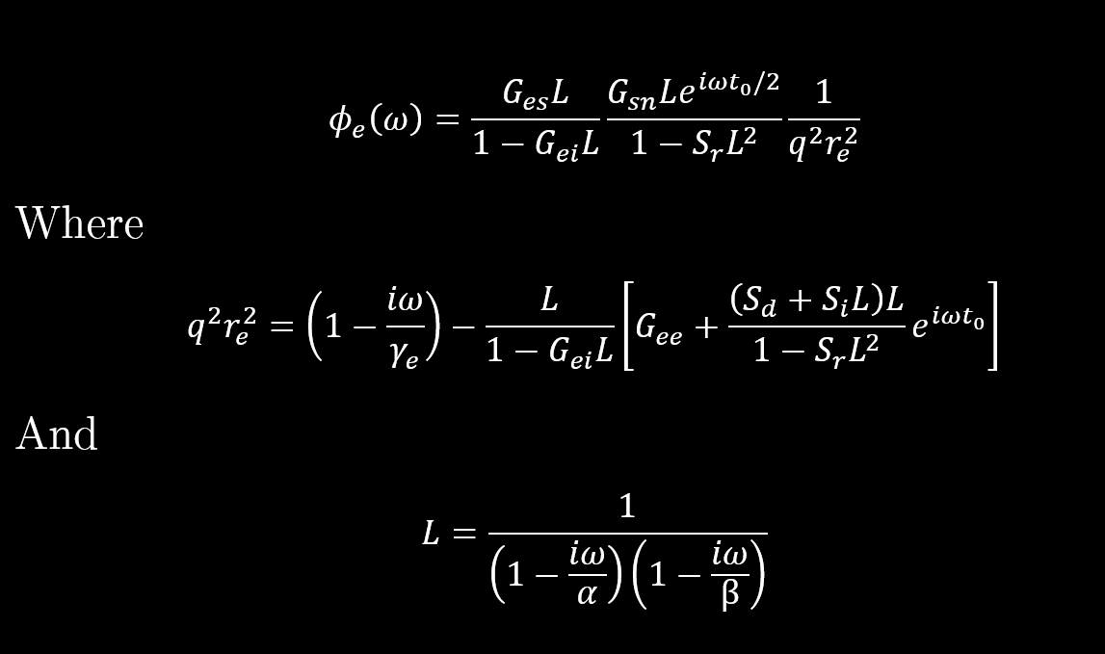


How Did We Model Brain Activity?
Figure 2: Eight variables, $α, γ_{e}, t_{0}, G_{ee}, G_{ei}, S_{d},S_{i},S_{r}$ are functions of age
From the literature, 1498 healthy subjects' empirical EEG spectra were fitted to a model of thalamocortical dynamics. Each parameter value was then determined as a function of age (figure 2).
Using the functions, EEG spectra could be modelled for each age by fitting to an inverse Fourier transform function, $φ_{e}\left(ω\right)$, spectral power as a function of frequency (figure 3).
Plots (next slide) made with the Python programming language. Spicy equations aren’t as difficult as they seem
Figure 3: Spectral Power plotting equations

Slide 5

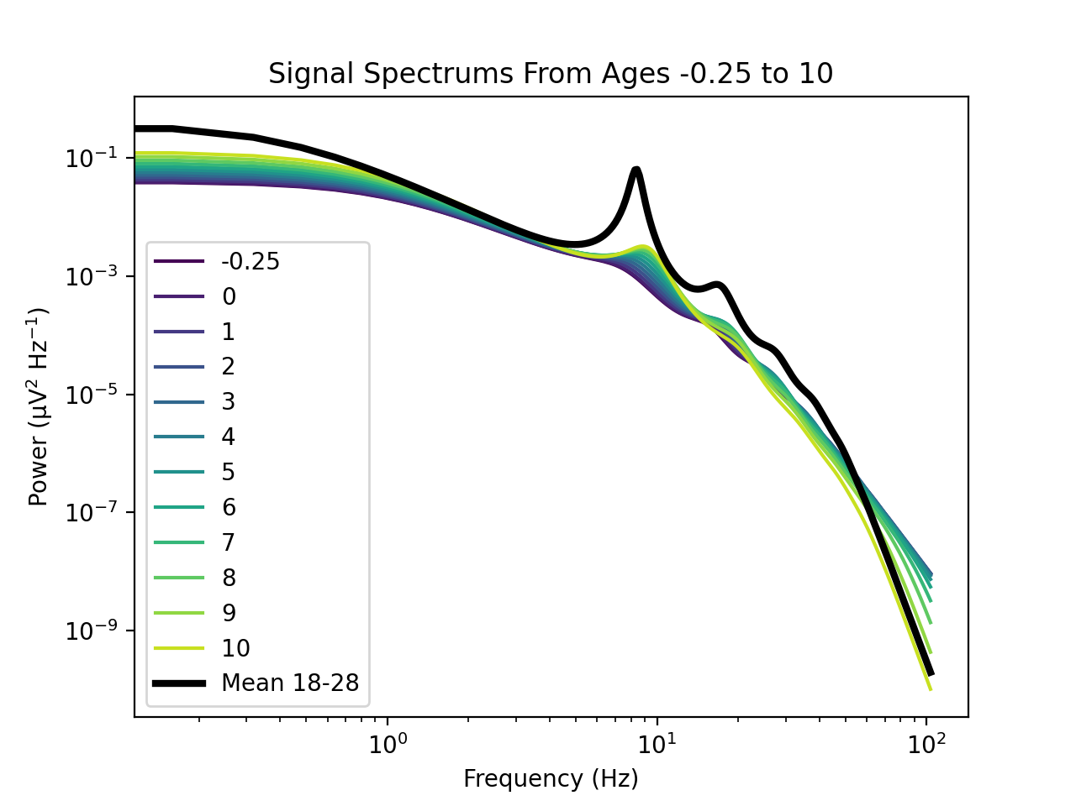
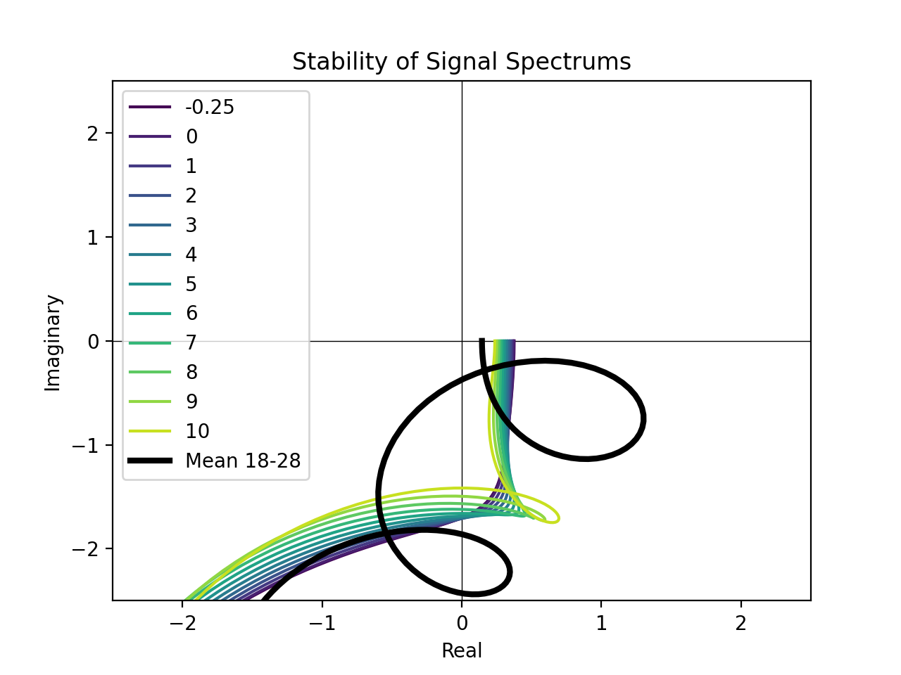
Modelling Infant Brain Activity Results
Figure 4: Modelled Spectral Power for each age
Figure 5: Stability of the signal for each age

Slide 6
Thanks for Listening! Any Questions?
Special thank you to my supervisor, Associate Professor Dr James Roberts @QIMR Berghofer! Thanks for answering all my questions, helping me understand the literature, and guiding me throughout the project!
Key References:
Herve, E., Mento, G., Desnous, B., and Fran cois, C. (2022). Challenges and new perspectives of developmental cognitive eeg studies. NeuroImage, 260:119508.
Marshall, P. J., Bar-Haim, Y., and Fox, N. A. (2002). Development of the eeg from 5 months to 4 years of age. Clinical Neurophysiology, 113(8):1199–1208.
Robinson, P.A., Rennie, C.J., and Rowe, D. L. (220). Dynamics of large-scale brain activity in normal arousal states and epileptic seizures. Phys. Rev. E, 65:041924.
van Albada, S., Kerr, C., Chiang, A., Rennie, C., and Robinson, P. (2010). Neurophysiological changes with age probed by inverse modelling of eeg spectra. Clinical Neurophysiology, 121(1):21-38.

